Slide 1
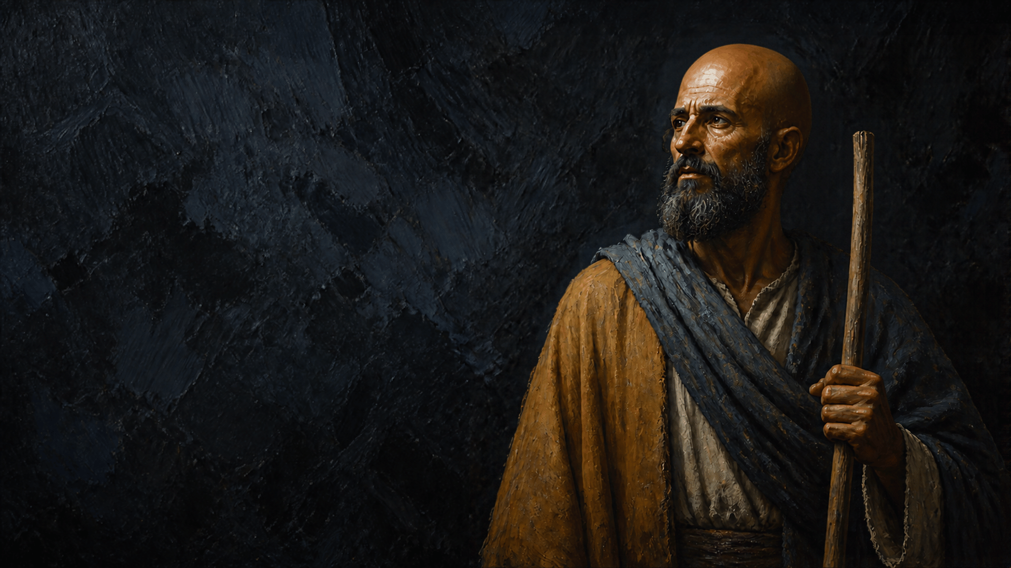
the
Man of God
אישׁ־האלהים
‘îš 'ĕlōhîm

Slide 2

Elisha: The “Man of God”
2 KINGS
The Sons of the Prophets (4:38-44)
Amos 7:14-15; 40-44
King Ben-Hadad of Syria (8:7-15)
7-8, 10-11, 14-15
The Holy Spirit (4-7, 13)
4:7; 4:21-22, 34-35; 5:8, 14-15; 5:20, 25-27;
6:6; 6:15-17; 7:2, 16-17; 13:19-20

Slide 3

Lessons for Us
2 Timothy 3:16-17
Use our abilities to feed and help others
Be willing to admonish when needed
Use our example to convince others Jesus is the Christ
Never be motivated by money or profit to do good
See the power and glory of God, taking courage
Trust in the promises of God (provisions both physical and spiritual)

Slide 4
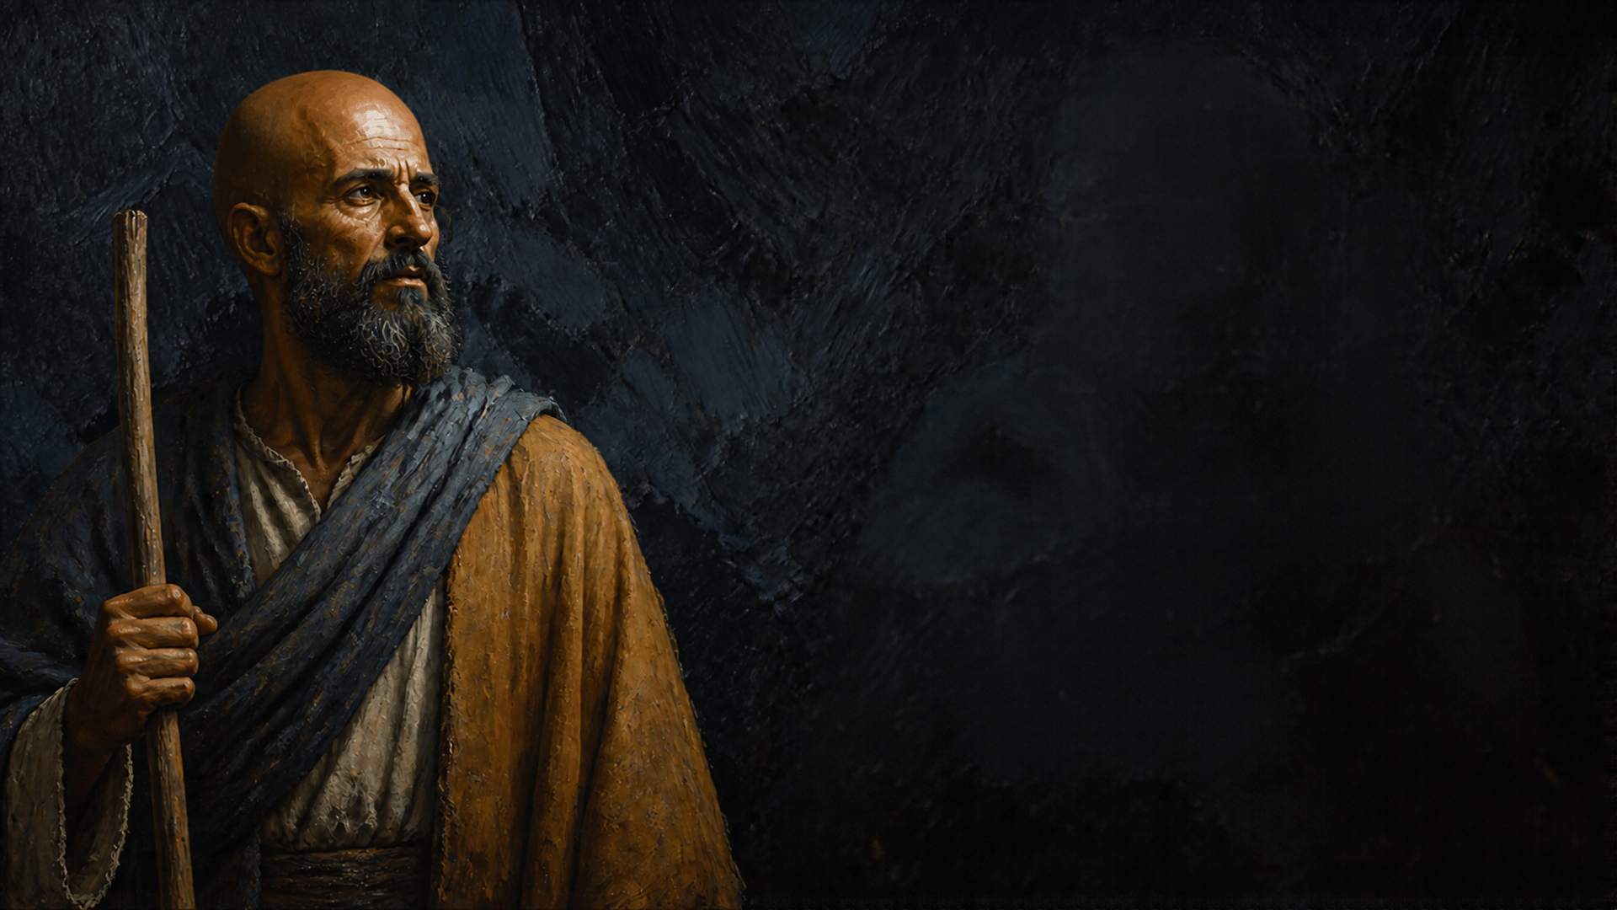
Conclusion
What men of God all have in common
Total Trust and Dedication to God
Ecclesiastes 12:13-14

